Slide 1

Name – Mayank Rai Project Title – ui/android app to mimick string movement (mid to large scale commercial use)
Mentorship – DR . Jay Bhatnagar
Designation – Professor
(Graphic era deemed to be university)

Slide 2
INTRODUCTION In this project I have made a app to calculate the BMI(Body mass index of the body with the help of android studio and java. In this project I have the designed the app using the xml and execute the code in java. It offers an intuitive user interface, input validation, instant BMI calculation, and clear classification of BMI results. This mini-project demonstrates the basic concepts of Android app development and can serve as a foundation for more advanced health and fitness applications.
Implementation Details
Development Environment
Android Studio IDE
Java programming language
XML for designing the user interface

Slide 3
Importance Health and Wellness Industry Growth: Addressing Health Concerns: Monetization Opportunities: Data Collection and Analytics: Integration with Other Health Apps: Corporate Wellness Programs: Healthcare Partnerships: User Engagement and Retention: Brand Recognition and Trust: Global Accessibility: Educational Value: Community Building:
This presentation explores the vital importance of developing and scaling such an application for mid to large-scale commercial use.

Slide 4
METHODOLOGY 1. open the android studio app and choose empty views activity and enter the project name and then I choose java language and click on finish 2. after that I have designed the xml file for first page 3.then I have write the code in java in main activity part 4.the pictures used be taken from drawable folder from laptop 5.after that I have the xml part for the final output page 6.then write the code in activity result part that shows the final output 7.then I merged both the xml and java code activity part for final output
BMI Calculation Logic
The BMI is calculated using the following formula:
BMI = weight (kg) / (height (m) * height (m))
The calculated BMI is then categorized into one of the following categories:
Underweight: BMI < 18.5
Normal Weight: 18.5 <= BMI < 24.9
Overweight: 25.0 <= BMI < 29.9
Obese: BMI >= 30.0

Slide 5
Project Setup: Install Android Studio and set up a new Android project. Configure the project with appropriate settings, including the minimum Android version, package name, and app name. User Interface (UI) Design: Design the user interface using XML layout files. Create input fields for height and weight. Add a "Calculate" button. Create a space to display the BMI result and classification. Input Validation: Implement input validation to ensure that the user enters valid height and weight values. Validate that the values are within reasonable ranges (e.g., height > 0, weight > 0). BMI Calculation Logic: Implement the BMI calculation logic in Java code. Extract the height and weight values from the input fields. Calculate the BMI using the formula: BMI = weight (kg) / (height (m) * height (m)).
BMI Classification: Compare the calculated BMI to predefined ranges to determine the BMI category (underweight, normal weight, overweight, or obese). Assign the appropriate category based on the calculated BMI value. Display Results:
Update the UI to display the calculated BMI and its classification to the user.
User Interaction:
Implement button click listeners to trigger the BMI calculation when the user presses the "Calculate" button.
Provide instant feedback to the user by displaying the result.
Testing:
Test the app on various Android devices and screen sizes to ensure proper functionality and UI responsiveness.
Verify that input validation works as expected.
Test the BMI calculation logic against known test cases.

Slide 6
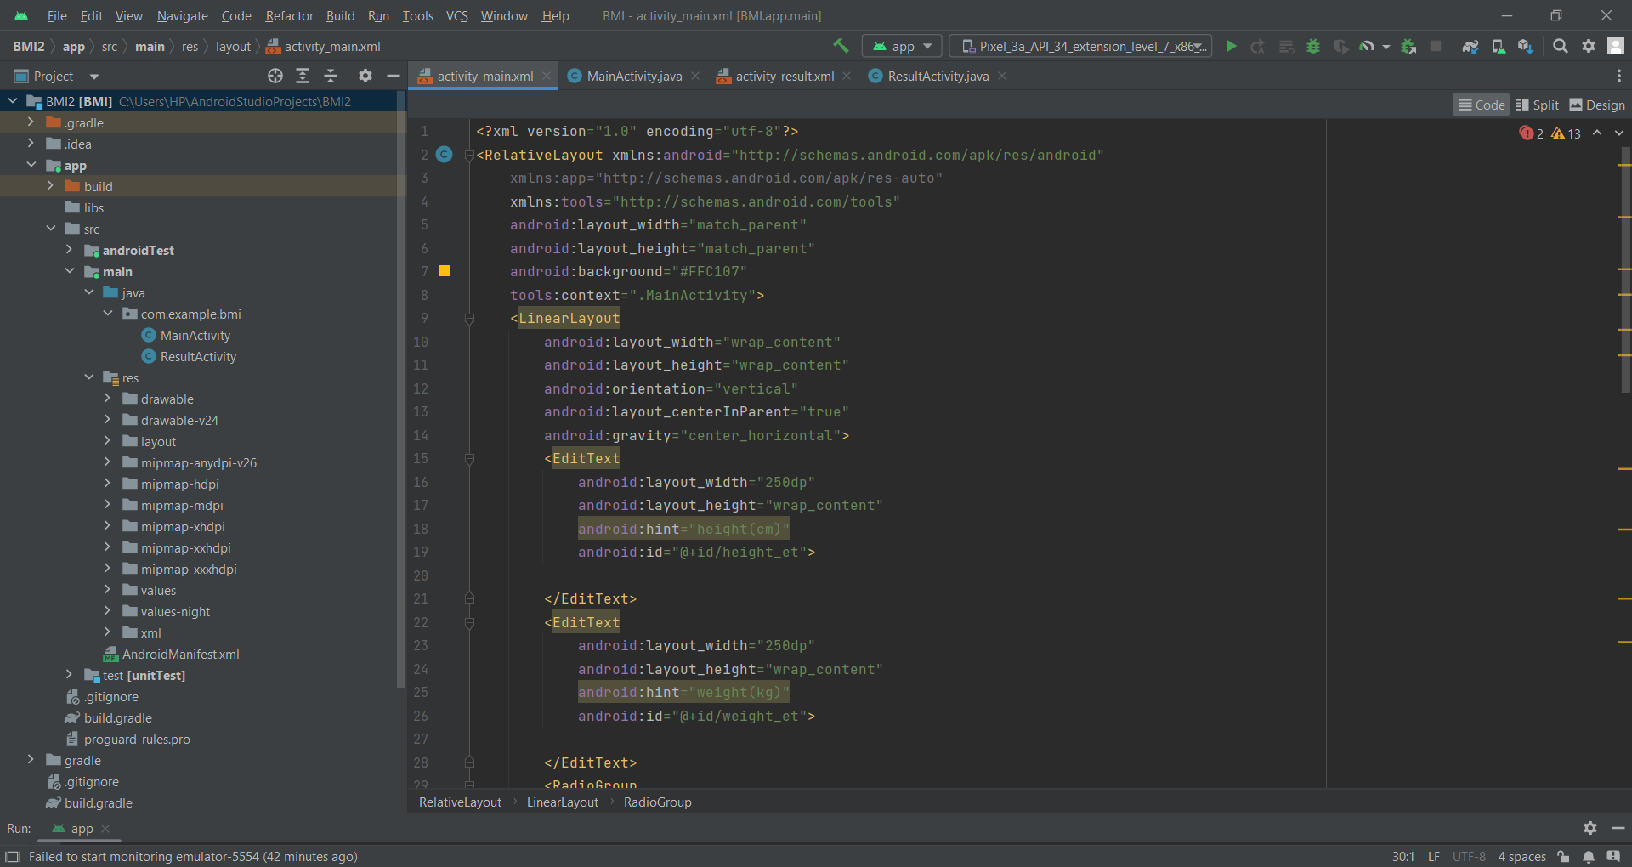
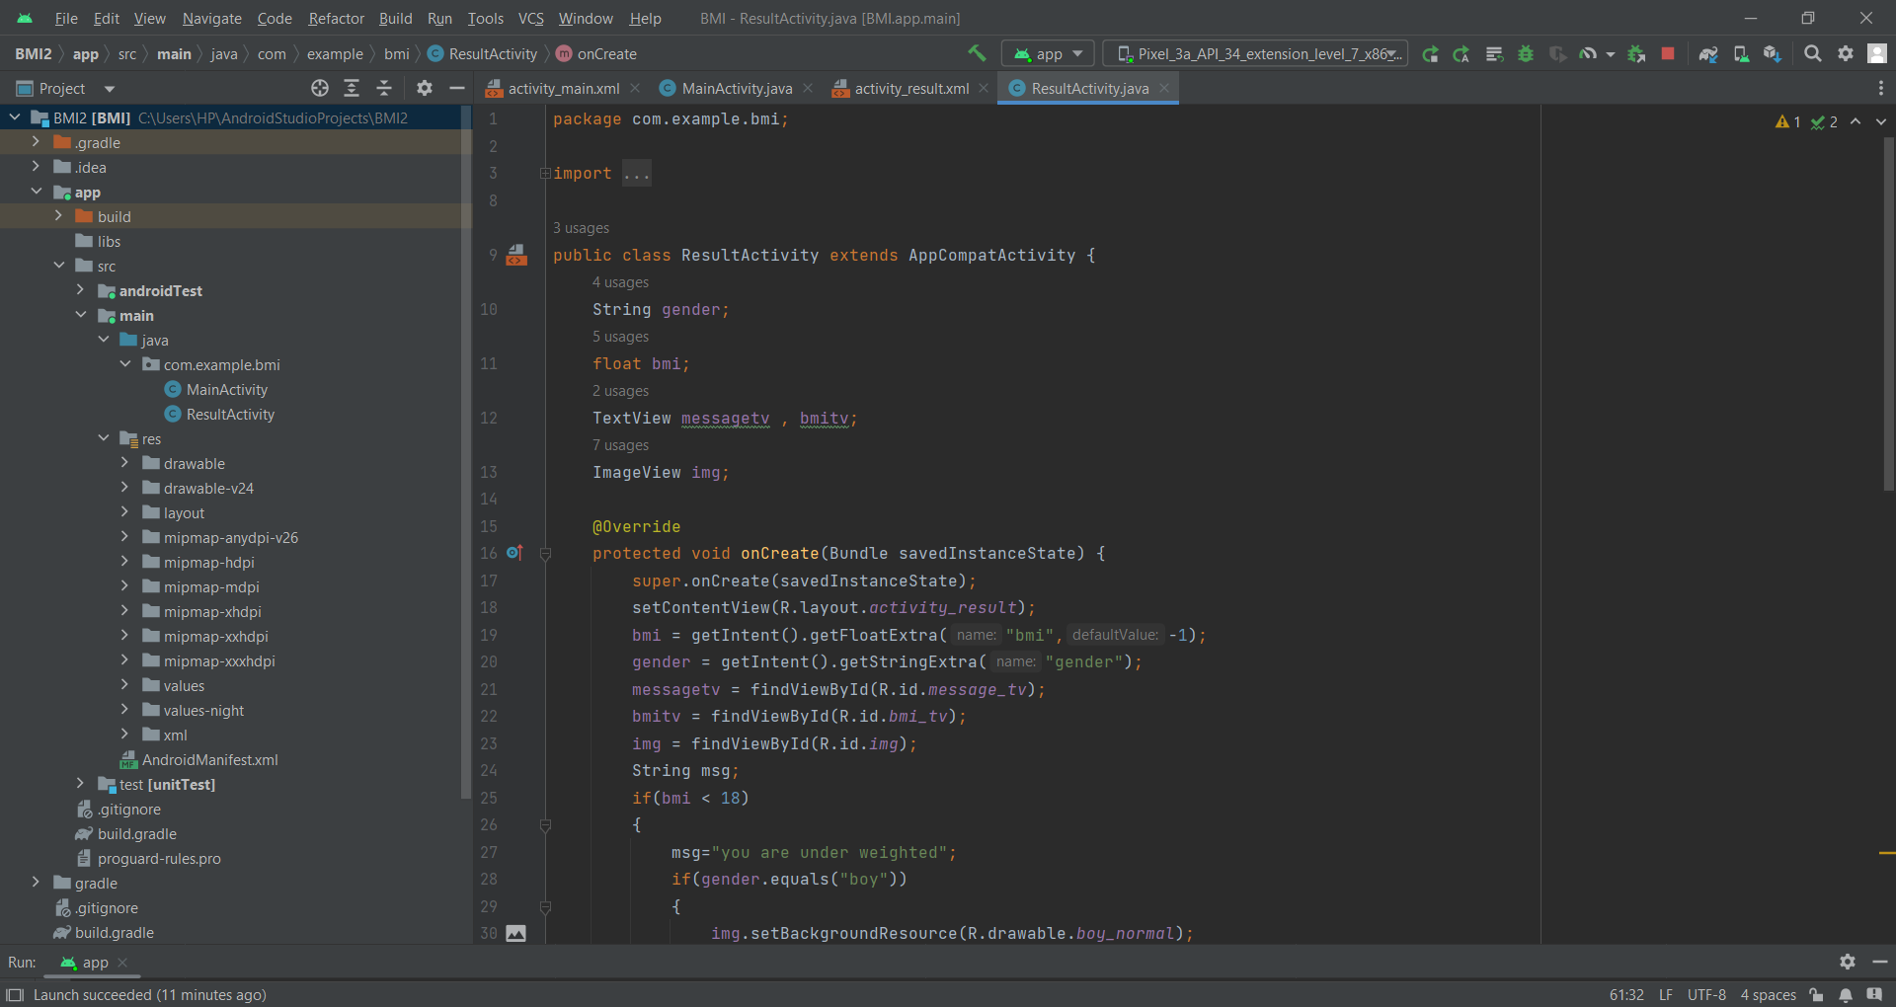
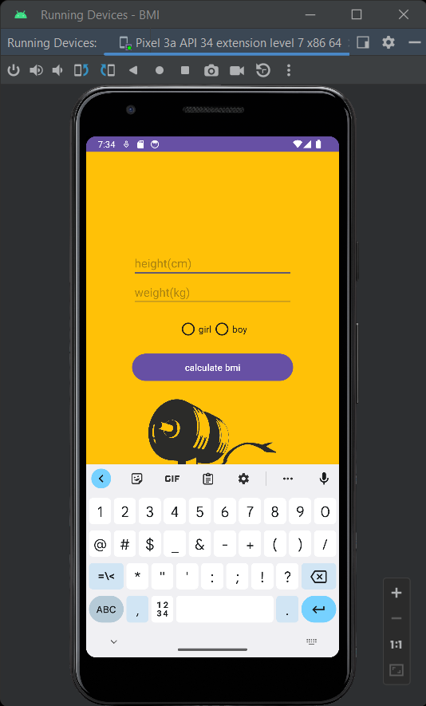
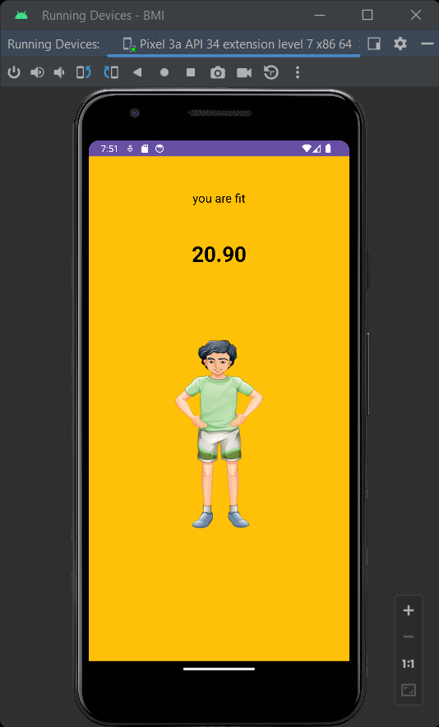
Xml part looks like this java part look like this
These two pictures shows the final output of the app

Slide 7
Results and discussion Result: After successfully creating the BMI Calculator App, the following outcomes were achieved: Functional App: The BMI Calculator App is fully functional, allowing users to calculate their BMI by entering their height and weight. It provides accurate results based on the standard BMI formula. User-Friendly Interface: The app features an intuitive and user-friendly interface with clear input fields, a "Calculate" button, and instant feedback on the BMI category. Input Validation: Input validation is implemented effectively, ensuring that users enter valid height and weight values and preventing erroneous calculations.
BMI Calculation: The app accurately calculates the user's BMI using the provided formula, taking into account the user's height and weight. BMI Classification: It classifies the calculated BMI into one of the standard categories (underweight, normal weight, overweight, or obese) based on predefined ranges. Results Display: The app displays the calculated BMI along with its classification, providing users with valuable health information. Testing: The app has been rigorously tested on various Android devices and screen sizes to ensure proper functionality and responsiveness. Input validation and BMI calculation logic have been verified against test cases.

Slide 8
User Experience: The app provides a straightforward and user-friendly experience. Users can quickly and easily obtain their BMI classification, making it a useful tool for monitoring their health. Accuracy: The app's BMI calculations are accurate, as they adhere to the standard formula. The classification into BMI categories is also consistent with established health guidelines. Validation: The input validation mechanism prevents users from entering unrealistic or invalid values for height and weight, enhancing the reliability of the results. Instant Feedback: The app provides instant feedback, giving users immediate access to their BMI information without the need for additional steps.
Future Enhancements: To further improve the app, future enhancements could include the ability to track BMI changes over time, offer personalized health recommendations, and support multiple units of measurement for height and weight. User Education: It's important to provide clear instructions within the app to guide users on how to use the BMI calculator effectively. Maintenance: Regular updates and maintenance will be necessary to address any issues that may arise, ensure compatibility with new Android versions, and incorporate user feedback and feature requests. Feedback Collection: Encourage users to provide feedback through app reviews or direct contact channels to continuously improve the app's performance and features.

Slide 9
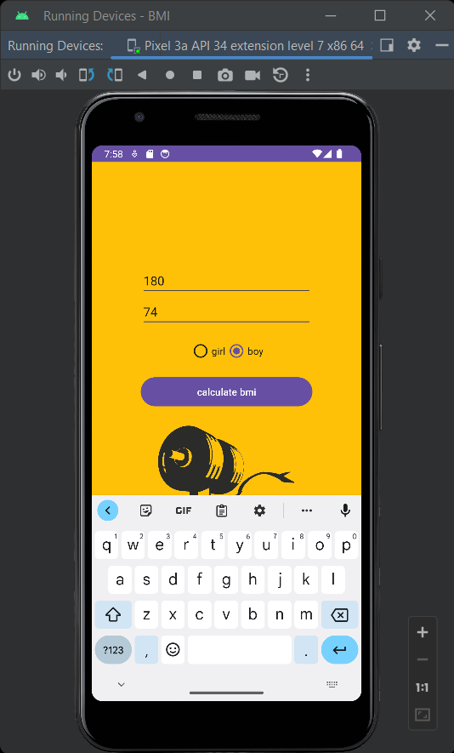
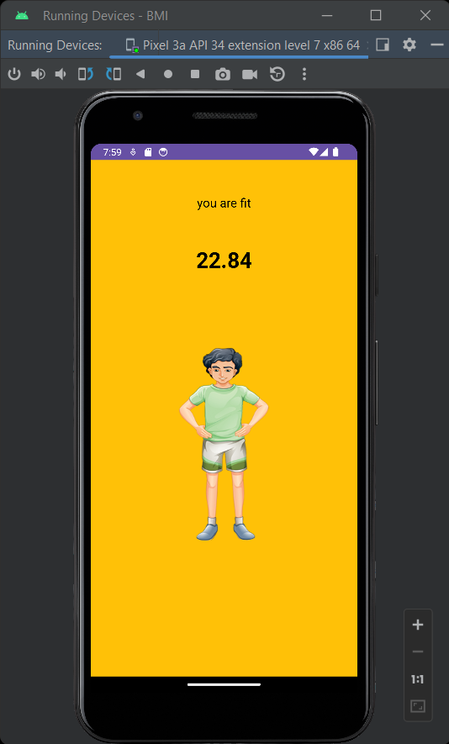
Final view of our app
In this app on the first page suppose we enter the details of height and weight and select the option for boy or girl and after applying the calculate bmi app button then on the final page of the app it shows the result with pictures which inhances the beauty our android app

Slide 10
Conclusion and future work The BMI Calculator App developed in Android Studio with Java provides a simple yet effective tool for users to assess their body mass index. It offers an intuitive user interface, input validation, instant BMI calculation, and clear classification of BMI results. This mini-project demonstrates the basic concepts of Android app development and can serve as a foundation for more advanced health and fitness applications.
To further improve the app, some possible future enhancements could include:
Storing user data and tracking BMI changes over time.
Providing dietary and exercise recommendations based on BMI category.
Supporting multiple units of measurement (e.g., allowing users to enter height in feet and inches).
Make app more efficient

